Slide 1
Software Requirements Engineering
Lecture 25
Data Analysis Models and Data Requirements

Slide 2
Event-response tables
Use cases and user stories aren’t always helpful or sufficient for discovering the functionality that developers must implement , particularly for real-time systems.
Consider a complex highway intersection with numerous traffic lights and pedestrian walk signals.
A driver might want to proceed through the light or to turn left or right.
A pedestrian wants to cross the road.
Perhaps an emergency vehicle wants to be able to turn the traffic signals green in its direction so it can speed its way to people who need help.
Law enforcement might have cameras at the intersection to photograph the license plates of red-light violators.
There aren’t many use cases for this system.

Slide 3
Event-response tables
Another way to approach user requirements is to identify the external events to which the system must respond.
An event is some change or activity that takes place in the user’s environment that stimulates a response from the software system.
An event-response table (also called an event table or an event list) itemizes all such events and the behavior the system is expected to exhibit in reaction to each event.

Slide 4
Classes of Events
Business event
A business event is an action by a human user that stimulates a dialog with the software, as when the user initiates a use case. The event-response sequences correspond to the steps in a use case or swimlane diagram.
Signal event
A signal event is registered when the system receives a control signal, data reading, or interrupt from an external hardware device or another software system
such as when a switch closes, a voltage changes, another application requests a service, or a user swipes his finger on a tablet’s screen.
Temporal event
A temporal event is time-triggered, as when the computer’s clock reaches a specified time
to launch an automatic data export operation at midnight
When a preset duration has passed since a previous event
as in a system that logs the temperature read by a sensor every 10 seconds

Slide 6
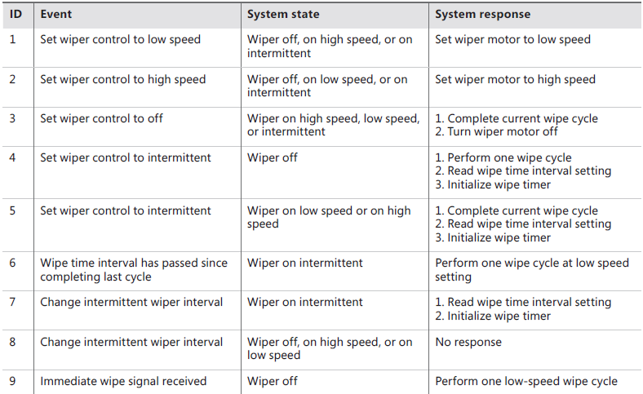
Partial event-response table for an automobile windshield-wiper system

Slide 7
Event-response tables
To identify events, consider all the states associated with the object you are analyzing, and identify any events that might transition the object into those states.
Listing the events that cross the system boundary is a useful scoping technique.
An event-response table that defines every possible combination of event, state, and response, including exception conditions, can serve as part of the functional requirements for that portion of the system.
The events in the event-response table should describe the essence of the event, not the specifics of the implementation.
Writing requirements at the essential avoids imposing unnecessary design constraints. However, record any known design constraints to guide the designer’s thinking.

Slide 8
UML diagrams
Many projects use object-oriented analysis, design, and development methods.
Objects typically correspond to real-world items in the business or problem domain.
They represent individual instances derived from a generic template called a class.
Class descriptions encompass both attributes (data) and the operations that can be performed on the attributes.

Slide 9
UML diagrams
Products developed using object-oriented methods don’t demand unique requirements development approaches.
Requirements development focuses on what the users need to do with the system and the functionality it must contain, not with how it will be constructed.
However, if you know that you’re going to build the system using object-oriented techniques, it can be helpful to begin identifying classes and their attributes and behaviors during requirements analysis.
This facilitates the transition from analysis to design, because the designer maps the problem-domain objects to the system’s objects and further details each class’s attributes and operations.

Slide 10
UML diagrams
The standard object-oriented modeling language is the Unified Modeling Language.
The UML is primarily used for creating design models. At the level of abstraction that’s appropriate for requirements analysis, several UML models can be useful.
Class diagrams, to show the object classes that pertain to the application domain; their attributes, behavior, and properties; and relations among classes.
Use case diagrams, to show the relationships between actors external to the system and the use cases with which they interact.
Activity diagrams, to show how the various flows in a use case interlace, or which roles perform certain actions (as in a swimlane diagram), or to model the flow of business processes.
State (or state machine) diagrams, to represent the different states a system or data object can take on and the allowed transitions between the states.

Slide 11
Modeling on agile projects
All projects should exploit requirements models to analyze their requirements from a variety of perspectives, no matter what the project’s development approach is.
The difference in how traditional and agile projects perform modeling is related to when the models are created and the level of detail in them.
You might create models in a less persistent or less perfected format on an agile project than on a traditional project.
The key point in using analysis models on agile projects—or really, on any project—is to focus on creating only the models you need, only when you need them, and only to the level of detail you need to make sure project stakeholders adequately understand the requirements.

Slide 12
Selecting the right models
System external interfaces
Context diagram
Use case diagram
Ecosystem map
Business process flow
Data flow diagram
Swimlane diagram
Activity Diagram
Data definitions and data object relationships
Entity-Relationship Diagram
Class Diagram
Data Dictionary

Slide 13
Selecting the right models
System and object states
State-transition diagrams and State tables
Event-response table
Functional Requirements
Complex logic
Decision tree
User interfaces
Dialog map
User task descriptions
User stories, scenarios, and use case specifications
Swimlane diagrams
Activity Diagram
Functional requirements
Nonfunctional requirements (quality attributes, constraints)
Natural language text but it lacks precision and completeness
A definitive technique for precisely specifying nonfunctional requirements called Planguage

Slide 14
Data Requirements
Computer systems manipulate data in ways that provide value to customers.
Data requirements pervade the three levels of requirements i.e., Business Requirements, User Requirements and Functional Requirements.
Software functionality is specified to create, modify, display, delete, process, and use data. The business analyst should begin collecting data definitions as they pop up during requirements elicitation.
The input and output flows on the context diagram represent major data elements at a high level of abstraction, which the BA can refine into details as elicitation progresses.
Nouns that users mention during requirements elicitation often indicate important data entities

Slide 15
Data Flow Diagram, Data Model, Data Dictionary
Just as the data flow diagram illustrates the processes that take place in a system, a data model depicts the system’s data relationships.
A data model provides the high-level view of the system’s data.
The data dictionary provides the detailed view.

Slide 16
Entity Relationship Diagram
A commonly used data model is the entity-relationship diagram or ERD.
ERD when used as a requirements analysis tool, represents logical groups of information from the problem domain and their interconnections without implying that the product will necessarily even include a database.
When you create an ERD during design, you’re defining the logical or physical (implementation) structure of the system’s database.

Slide 17
Entities and Relationships
Entities could represent physical items (including people) or aggregations of data that are important to the business you’re analyzing or to the system you intend to build.
Entities are named as singular nouns and are shown in rectangles in an ERD.
Each entity is described by one or more attributes; individual instances of an entity will have different attribute values.
The data dictionary contains the precise definitions of those attributes.
The diamonds in the ERD represent relationships, which identify the logical linkages between pairs of entities. Relationships are named in a way that describes the nature of the connection.

Slide 18
Partial entity-relationship diagram for the Chemical Tracking System.

Slide 19
Cardinality in ERD
The cardinality, or multiplicity, of each relationship is shown with a number or letter on the lines that connect entities and relationships.
Different ERD notations use different conventions to represent cardinality;
If you know that a more precise cardinality exists than simply many (one person has exactly two biological parents), you can show the specific number or range of numbers instead of the generic M.
Alternative ERD notations use different symbols on the lines connecting entities and relationships to indicate cardinality.

Slide 20
One alternative notation for an entity-relationship diagram.

Slide 21
Class Diagram as a Data Model
Teams that are applying object-oriented development methods will draw UML class diagrams, which show the data attributes for individual classes (which correspond to entities in the ERD), the logical links between classes, and the cardinalities of those links.
Note that the class diagram also lists the attributes associated with each class in the middle section of the rectangle.
When class diagrams are used for object-oriented analysis or design, the bottommost section of a class rectangle (empty in this example) normally shows the operations, or behaviors, that an object of the class can perform. For data modeling, though, that third section of the class rectangle is left empty.

Slide 22
Portion of a UML class diagram for the Chemical Tracking System.

Slide 23
Data Dictionary
A data dictionary is a collection of detailed information about the data entities used in an application.
Collecting the information about composition, data types, allowed values, and the like into a shared resource identifies the data validation criteria, helps developers write programs correctly, and minimizes integration problems.
The data dictionary complements the project glossary, which defines application domain or business terms, abbreviations, and acronyms.
It is recommended keeping the data dictionary and the glossary separate.
Data definitions often are reusable across applications, particularly within a product line.

Slide 24
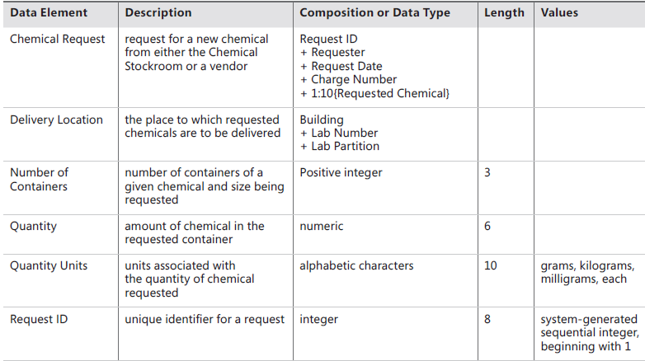

Slide 25
Data Dictionary
Entries in the data dictionary can represent the following types of data elements.
Primitive
A primitive data element is one for which no further decomposition is possible or necessary. You can use other columns in the data dictionary to describe each primitive’s data type, length, numerical range, list of allowed values (as with Quantity Units), and other pertinent attributes.
Structure
A data structure (or a record) is composed of multiple data elements.
The “Composition or Data Type” column in the data dictionary is a place to list the elements that make up the structure, separating the elements with plus (+) signs.
Structures also can incorporate other structures.
If an element in a data structure is optional (a value doesn’t have to be supplied by the user or the system), enclose it in parentheses.
If multiple instances of a particular data element can appear in a structure, enclose that item in curly braces. Show the allowed number of possible repeats in the form minimum:maximum in front of the opening curly brace

Slide 26
When performing data analysis, you can map various information representations against one another to find gaps, errors, and inconsistencies.
The entities in your entity-relationship diagram are likely defined in the data dictionary.
The data flows and stores in your DFD are probably found somewhere in your ERD, as well as in the data dictionary.
The display fields found in a report specification also should appear in the data dictionary.
During data analysis, you can compare these complementary views to identify errors and further refine your data requirements.
A CRUD matrix is a rigorous data analysis technique for detecting missing requirements. CRUD stands for Create, Read, Update, and Delete. A CRUD matrix correlates system actions with data entities to show where and how each significant data entity is created, read, updated, and deleted. (Some people add an L to the matrix to indicate that the entity appears as a List selection, M to indicate moving data from one location to another, and perhaps a second C to indicate copying data. We’ll stick with CRUD here for simplicity.) Depending on the requirements approaches you are using, you can examine various types of correlations, including the following:
Data entities and system events (Ferdinandi 2002; Robertson and Robertson 2013)
Data entities and user tasks or use cases (Lauesen 2002)
Object classes and use cases (Armour and Miller 2001)

